Slide 1
PERFORMING ARTS
DANCE

Slide 2
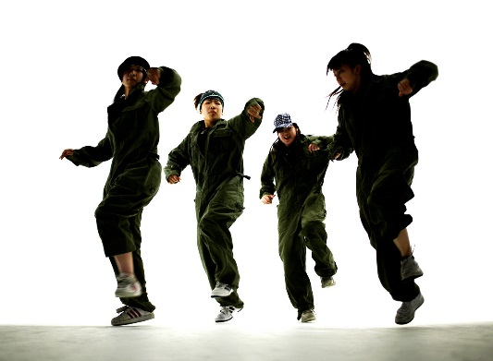
Success Criteria
Participate in an effective warm up showing focus, energy and determination.
Continue to learn the street dance routine that the uses the 5 basic actions and identify them!

Slide 3
Success Criteria
Level | Dance Strand
 | 1 Creating | 2 Performing | 3 Reflecting
Entry | I can remember a range of actions I can create phrases based on a stimulus or music | I can participate in a short group performance I show some consideration of spatial awareness in performance | I can recognise when my own work and the work of others’, could be improved
1 | I can perform simple dance phrase demonstrating choreographic skills | I can use appropriate characterisation in a performance | I can talk about why I made certain decisions in my choreography I can show a basic understanding of how a stimuli can be conveyed
2 | I can create a choreography using unison and cannon I can learn teacher led sequences and then use these to develop my own levels I can create a choreography using a range of stimuli I can take on feedback to improve my choreography such as using levels and/or contract work I can sustain a focus within a performance | I can learn a routine and take part in simple performances | I can give suggestions on how work could be improved I can talk about my work using some dance terminology I can identify strengths and weaknesses in my own and others work
3 | I can select and apply movement to match the given dance style I can work confidently in a group using a range of choreographic devices to explore different dance styles and ideas I can create and rehearse performance that make use of the range of techniques and dynamics to express my ideas I can give and accept suggestions to/from peers and teachers during the rehearsal process I can learn and create dances in a variety of styles | I experiment with different actions to create a performance I can create routines that are appropriate to the given style or stimuli I can experiment with different styles/actions and dynamics when developing a routine I improve and refine my performance through the rehearsal process I can choreograph a short performance for an audience I can perform a variety of different dance styles | I can reflect on and evaluate my own and other pupils’ work, suggesting improvements I can use key words when talking about dances that I have seen or participated in I can discuss the ways that ideas are communicated

Slide 4
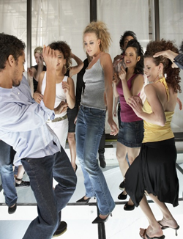
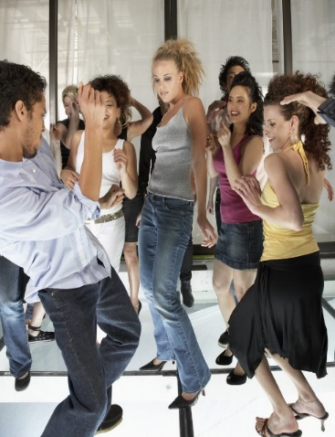
KEY WORDS
DYNAMICS- THE WAY IN WHICH YOU PERFORM A MOVEMENT.
MUSICALITY- KEEPING IN TIME WITH THE MUSIC
FOCUS- KEEPING YOUR HEAD UP.
ENERGY- KEEPING YOUR STAMINA UP

Slide 5
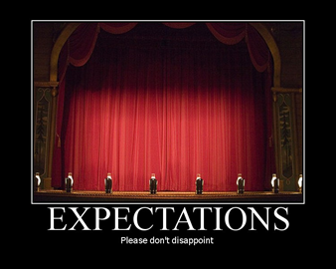

RECAP OF EXPECTATIONS
BE RESPECTFUL OF OTHERS IN THE CLASS.
TRY YOUR HARDEST AT ALL TIMES.
LISTEN TO FEEDBACK AND USE THIS CONSTRUCTIVELY TO IMPROVE YOUR PERFORMANCE.
LISTEN TO THE TEACHER AT ALL TIMES.
BE ABLE TO WORK AS A GROUP AND INDEPENDENTLY.
BE CREATIVE.
USE THE STAGE EFFECTIVELY.
LISTEN TO YOUR PEERS IDEAS

Slide 6
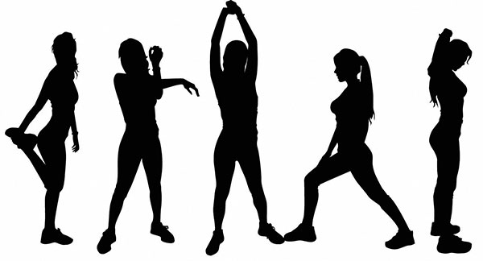
TEACHER LEAD WARM UP

Slide 7


TASK.
GET INTO GROUPS OF NO MORE THAN 4 AND USING THE 5 BASIC DANCE ACTIONS CREATE YOUR OWN MINI WARM UP WHICH YOU WILL TEACH TO THE REST OF THE CLASS NEXT WEEK..
Jump
Hop
Travel
Stillness/gesture
Turn/rotate

Slide 8

STREET DANCE
RECAP SECTION 1 AND 2 OF THE STREET DANCE ROUTINE.
WHAT DYNAMICS HAVE BEEN USED SO FAR?
WHERE SHOULD YOUR FOCUS BE?
LEARN SECTION 3 OF THE SREET DANCE ROUTINE.

Slide 9

ASSESSMENT TIME
In 2 groups you will now perform the routine to each other.
AUDIENCE ARE GOING TO BE THE JUDGES. YOU NEED TO COMMENT ON:
WHAT WENT WELL WITH THE PERFORMANCE?
WHAT DO YOU FEEL COULD BE IMPROVED?USE KEY DANCE WORDS.

Slide 10
PLENARY
What have you learnt today?
WHAT ARE DYNAMICS?
WHAT IS MUSICALITY?
WHERE DOES YOU FOCUS NEED TO BE?
Each corner of the room is a level. Go to the corner you think you are at and be ready to explain why and how you could improve.

